Slide 1
How to do
an Oral Book Review

Slide 2
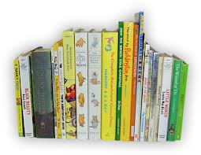
An Introduction
What is the Title of the book?
Who is the Author?
Who is the Illustrator?

Slide 3
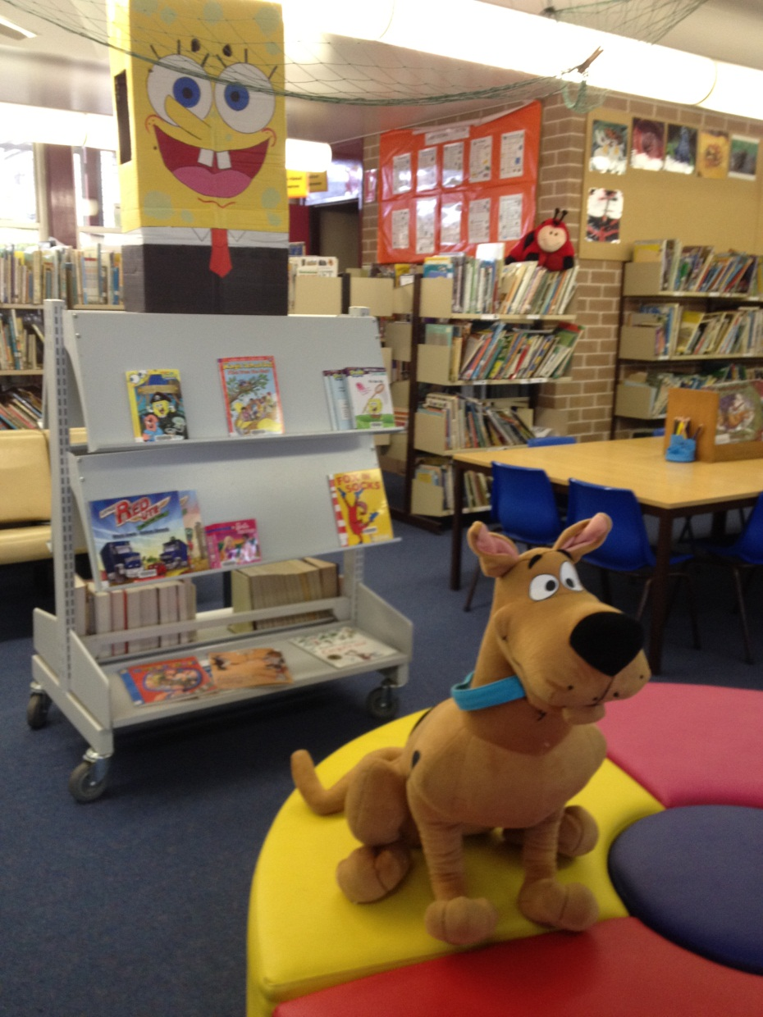
Genre
Drama Horror
Science-fiction Fantasy
Crime Adventure
Mystery
Humorous
Animal -fiction SPORT
Historical-fiction
Family and relationships

Slide 4
The Plot
What is the story about?
A brief description without giving away the ending

Slide 5

The Setting
Where does the story take place?
What period of time? (Pre-historic, Ancient, Medieval, Modern-Contempary, Future)
Where does the story take place?
Country, Town, Village, Schoolyard, Castle, City, Beach

Slide 6
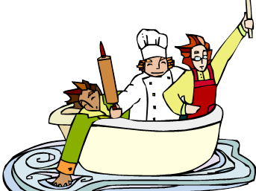
The Characters
Who are the main Characters?
Name, description
Personality traits
Examples from the text

Slide 7
Your recommendations!
Did you enjoy the book? Why or Why not?
Has the author written other books that you know of or have enjoyed reading?
Is it part of a series?
Who do you think would also enjoy reading this book?
What age and interest group?
What rating would you give the book?

